Slide 1

HEAT AND MASS TRANSFER IN MHD FLOW OVER AN EXPONENTIALLY STRETCHING SHEET IN A THERMALLY STRATIFIED MEDIUM
Prepared by: Nur Iman Nazirah

Slide 2
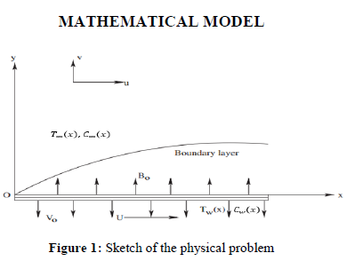
Introduction
MHD is applied in a process of cooling nuclear.
Applied in magnetic field is
important in controlling the
heat and mass transfer in fluid
flow.
A thermally stratified medium
is layering of bodies based on
temperature difference.
Figure 1 shows the flow of an
incompressible viscous
elecrtrically conducting fluid.

Slide 3
objective
01
To derive the similarity transformations.
02
To investigate the researcher paper on how they solve the problem.
03
To solve the PDE equation, we need to reduce the higher order to ODE.
To solve the ODE equation by using numerical method which is Runge Kutta Method with Matlab software.
04

Slide 4
methodolgy
Similarity transformation
PDE to ODE
Runge Kutta
Bc’s

Slide 5
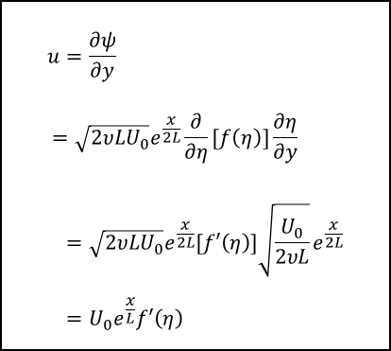
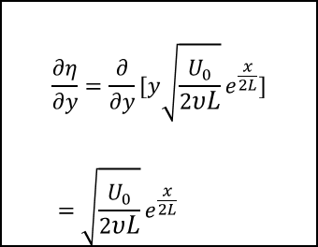

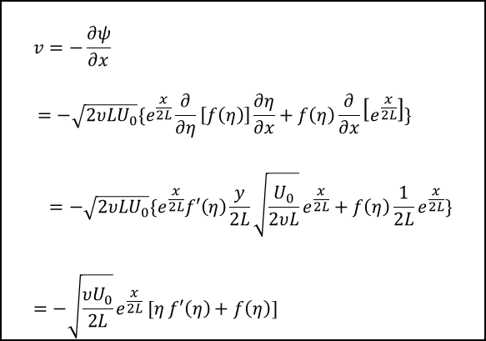



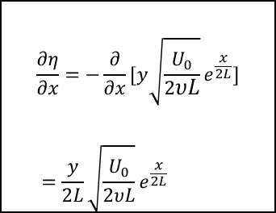
$$u=\frac{∂ψ}{∂y} \\ =\sqrt{2υLU_{0}}e^{\frac{x}{2L}}\frac{∂}{∂η}[f\left(η\right)]\frac{∂η}{∂y} \\ =\sqrt{2υLU_{0}}e^{\frac{x}{2L}}[f′\left(η\right)]\sqrt{\frac{U_{0}}{2υL}}e^{\frac{x}{2L}} \\ ={U_{0}e}^{\frac{x}{L}}f′\left(η\right)$$
Similarity transformation
$$\frac{∂η}{∂y}=\frac{∂}{∂y}[y\sqrt{\frac{U_{0}}{2υL}}e^{\frac{x}{2L}}] \\ =\sqrt{\frac{U_{0}}{2υL}}e^{\frac{x}{2L}}$$
$$η=y\sqrt{\frac{U_{0}}{2υL}}e^{\frac{x}{2L}}$$
$$v=−\frac{∂ψ}{∂x} \\ =−\sqrt{2υLU_{0}}\{e^{\frac{x}{2L}}\frac{∂}{∂η}\left[f\left(η\right)\right]\frac{∂η}{∂x}+f\left(η\right)\frac{∂}{∂x}\left[e^{\frac{x}{2L}}\right]\} \\ =−\sqrt{2υLU_{0}}\{e^{\frac{x}{2L}}f′\left(η\right)\frac{y}{2L}\sqrt{\frac{U_{0}}{2υL}}e^{\frac{x}{2L}}+f\left(η\right)\frac{1}{2L}e^{\frac{x}{2L}}\} \\ =−\sqrt{\frac{{υU}_{0}}{2L}}e^{\frac{x}{2L}} [η f′\left(η\right)+f\left(η\right)]$$
$$ψ=\sqrt{2υLU_{0}}e^{\frac{x}{2L}}f(η)$$
$$θ(η)=\frac{T−T_{∞}(x)}{T_{w}\left(x\right)−T_{0}}$$
$$\frac{∂η}{∂x}=−\frac{∂}{∂x}[y\sqrt{\frac{U_{0}}{2υL}}e^{\frac{x}{2L}}] \\ =\frac{y}{2L}\sqrt{\frac{U_{0}}{2υL}}e^{\frac{x}{2L}}$$
$$φ(η)=\frac{C−C_{∞}(x)}{C_{w}\left(x\right)−C_{∞}(x)}$$

Slide 6
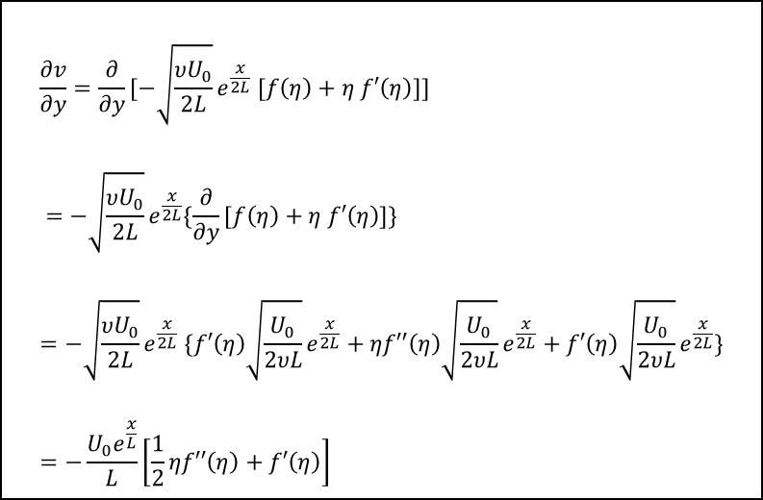
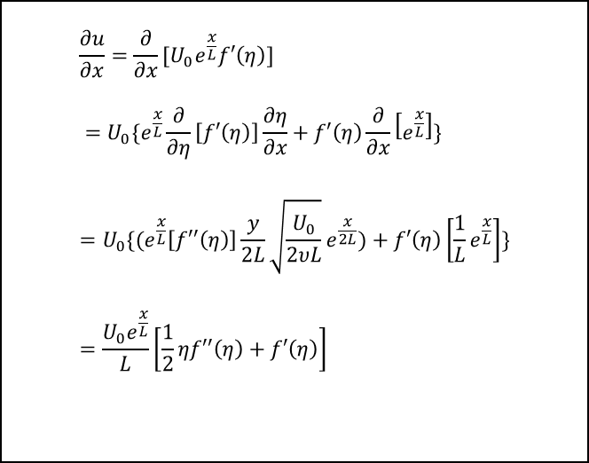
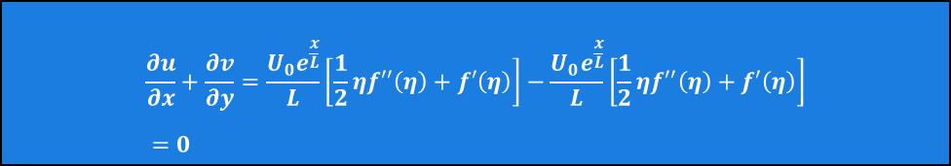
$$\frac{∂u}{∂x}=\frac{∂}{∂x}[{U_{0}e}^{\frac{x}{L}}f′\left(η\right)] \\ =U_{0}\{e^{\frac{x}{L}}\frac{∂}{∂η}\left[f′\left(η\right)\right]\frac{∂η}{∂x}+f′\left(η\right)\frac{∂}{∂x}\left[e^{\frac{x}{L}}\right]\} \\ =U_{0}\{(e^{\frac{x}{L}}\left[f′′\left(η\right)\right]\frac{y}{2L}\sqrt{\frac{U_{0}}{2υL}}e^{\frac{x}{2L}})+f′\left(η\right)\left[\frac{1}{L}e^{\frac{x}{L}}\right]\} \\ =\frac{U_{0}e^{\frac{x}{L}}}{L}\left[\frac{1}{2}ηf′′\left(η\right)+f′\left(η\right)\right]$$
$$\frac{∂v}{∂y}=\frac{∂}{∂y}[−\sqrt{\frac{{υU}_{0}}{2L}}e^{\frac{x}{2L}} [f\left(η\right)+η f′\left(η\right)]] \\ =−\sqrt{\frac{{υU}_{0}}{2L}}e^{\frac{x}{2L}}\{\frac{∂}{∂y}[f\left(η\right)+η f′\left(η\right)]\} \\ =−\sqrt{\frac{{υU}_{0}}{2L}}e^{\frac{x}{2L}} \{f′\left(η\right)\sqrt{\frac{U_{0}}{2υL}}e^{\frac{x}{2L}}+ηf′′\left(η\right)\sqrt{\frac{U_{0}}{2υL}}e^{\frac{x}{2L}}+f′\left(η\right)\sqrt{\frac{U_{0}}{2υL}}e^{\frac{x}{2L}}\} \\ =−\frac{U_{0}e^{\frac{x}{L}}}{L}\left[\frac{1}{2}ηf′′\left(η\right)+f′\left(η\right)\right]$$
$$\frac{∂u}{∂x}+\frac{∂v}{∂y}=\frac{U_{0}e^{\frac{x}{L}}}{L}\left[\frac{1}{2}ηf′′\left(η\right)+f′\left(η\right)\right]−\frac{U_{0}e^{\frac{x}{L}}}{L}\left[\frac{1}{2}ηf′′\left(η\right)+f′\left(η\right)\right] \\ =0$$

Slide 7
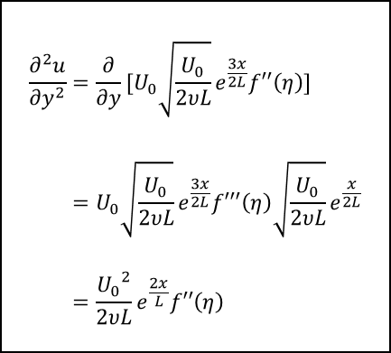
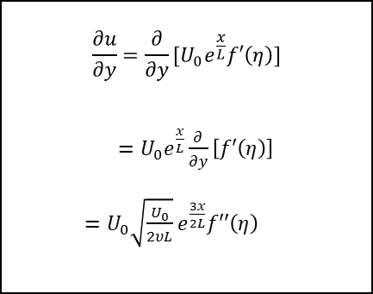
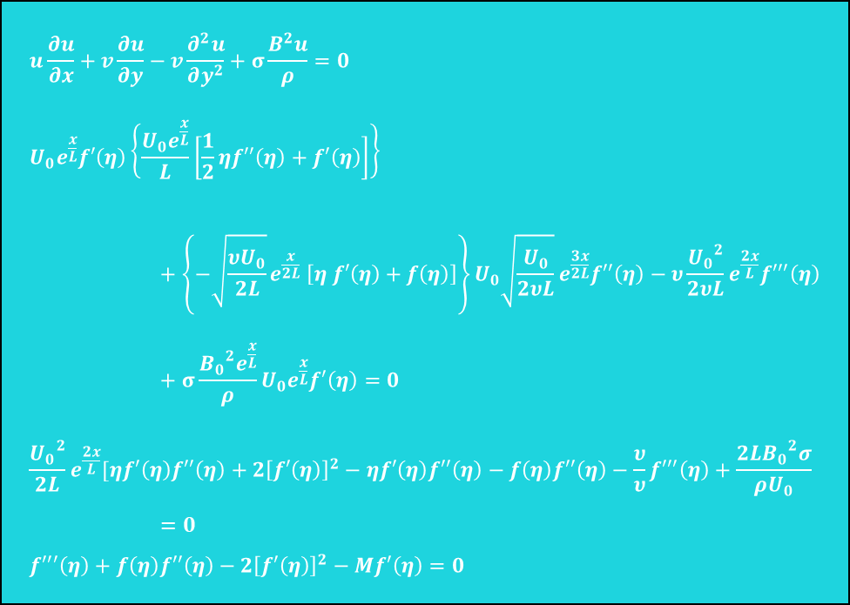
$$\frac{∂u}{∂y}=\frac{∂}{∂y}[{U_{0}e}^{\frac{x}{L}}f′\left(η\right)]$$ $=U_{0}e^{\frac{x}{L}}\frac{∂}{∂y}\left[f′\left(η\right)\right]$ $=U_{0}\sqrt{\frac{U_{0}}{2υL}}e^{\frac{3x}{2L}}f′′\left(η\right)$
$$u\frac{∂u}{∂x}+v\frac{∂u}{∂y}−v\frac{∂^{2}u}{∂y^{2}}+σ\frac{B^{2}u}{ρ}=0 \\ {U_{0}e}^{\frac{x}{L}}f′\left(η\right)\left\{\frac{U_{0}e^{\frac{x}{L}}}{L}\left[\frac{1}{2}ηf′′\left(η\right)+f′\left(η\right)\right]\right\}+{\left\{−\sqrt{\frac{{υU}_{0}}{2L}}e^{\frac{x}{2L}} \left[η f′\left(η\right)+f\left(η\right)\right]\right\}U}_{0}\sqrt{\frac{U_{0}}{2υL}}e^{\frac{3x}{2L}}f′′\left(η\right)−υ\frac{{U_{0}}^{2}}{2υL}e^{\frac{2x}{L}}f′′′\left(η\right)+σ\frac{{B_{0}}^{2}e^{\frac{x}{L}}}{ρ}{U_{0}e}^{\frac{x}{L}}f′\left(η\right)=0 \\ \frac{{U_{0}}^{2}}{2L}e^{\frac{2x}{L}}[ηf′\left(η\right)f′′\left(η\right)+2{\left[f′\left(η\right)\right]}^{2}−ηf′\left(η\right)f′′\left(η\right)−f\left(η\right)f′′\left(η\right)−\frac{υ}{υ}f′′′\left(η\right)+\frac{{{2LB}_{0}}^{2}σ}{ρU_{0}}=0 \\ f′′′\left(η\right)+f\left(η\right)f′′\left(η\right)−2{\left[f′\left(η\right)\right]}^{2}−Mf′\left(η\right)=0$$
$$\frac{∂^{2}u}{∂y^{2}}=\frac{∂}{∂y}[U_{0}\sqrt{\frac{U_{0}}{2υL}}e^{\frac{3x}{2L}}f′′\left(η\right)] \\ =U_{0}\sqrt{\frac{U_{0}}{2υL}}e^{\frac{3x}{2L}}f′′′\left(η\right)\sqrt{\frac{U_{0}}{2υL}}e^{\frac{x}{2L}} \\ =\frac{{U_{0}}^{2}}{2υL}e^{\frac{2x}{L}}f′′\left(η\right)$$

Slide 8
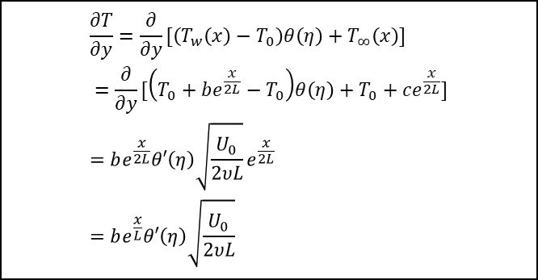
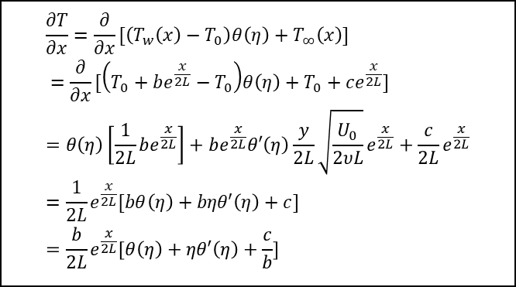
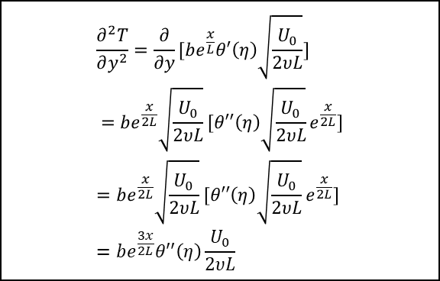
$$\frac{∂T}{∂x}=\frac{∂}{∂x}[\left(T_{w}\left(x\right)−T_{0}\right)θ\left(η\right)+T_{∞}\left(x\right)] \\ =\frac{∂}{∂x}[\left(T_{0}+be^{\frac{x}{2L}}−T_{0}\right)θ\left(η\right)+T_{0}+ce^{\frac{x}{2L}}] \\ =θ\left(η\right)\left[\frac{1}{2L}be^{\frac{x}{2L}}\right]+be^{\frac{x}{2L}}θ′\left(η\right)\frac{y}{2L}\sqrt{\frac{U_{0}}{2υL}}e^{\frac{x}{2L}}+\frac{c}{2L}e^{\frac{x}{2L}} \\ =\frac{1}{2L}e^{\frac{x}{2L}}[bθ\left(η\right)+bηθ′\left(η\right)+c] \\ =\frac{b}{2L}e^{\frac{x}{2L}}[θ\left(η\right)+ηθ′\left(η\right)+\frac{c}{b}]$$
$$\frac{∂^{2}T}{∂y^{2}}=\frac{∂}{∂y}[be^{\frac{x}{L}}θ′\left(η\right)\sqrt{\frac{U_{0}}{2υL}}] \\ =be^{\frac{x}{2L}}\sqrt{\frac{U_{0}}{2υL}}[θ′′\left(η\right)\sqrt{\frac{U_{0}}{2υL}}e^{\frac{x}{2L}}] \\ =be^{\frac{x}{2L}}\sqrt{\frac{U_{0}}{2υL}}[θ′′\left(η\right)\sqrt{\frac{U_{0}}{2υL}}e^{\frac{x}{2L}}] \\ =be^{\frac{3x}{2L}}θ′′\left(η\right)\frac{U_{0}}{2υL}$$
$$\frac{∂T}{∂y}=\frac{∂}{∂y}[\left(T_{w}\left(x\right)−T_{0}\right)θ\left(η\right)+T_{∞}\left(x\right)] \\ =\frac{∂}{∂y}[\left(T_{0}+be^{\frac{x}{2L}}−T_{0}\right)θ\left(η\right)+T_{0}+ce^{\frac{x}{2L}}] \\ =be^{\frac{x}{2L}}θ′\left(η\right)\sqrt{\frac{U_{0}}{2υL}}e^{\frac{x}{2L}} \\ =be^{\frac{x}{L}}θ′\left(η\right)\sqrt{\frac{U_{0}}{2υL}}$$

Slide 9
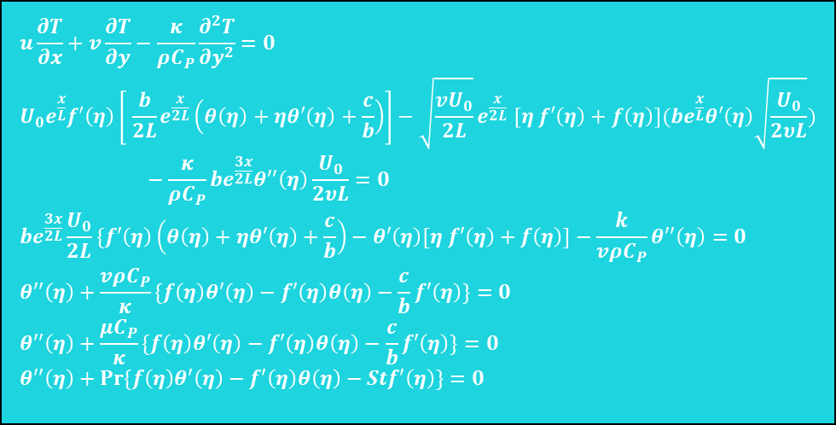
$$u\frac{∂T}{∂x}+v\frac{∂T}{∂y}−\frac{κ}{ρC_{P}}\frac{∂^{2}T}{∂y^{2}}=0 \\ {U_{0}e}^{\frac{x}{L}}f′\left(η\right)\left[ \frac{b}{2L}e^{\frac{x}{2L}}\left(θ\left(η\right)+ηθ′\left(η\right)+\frac{c}{b}\right)\right]−\sqrt{\frac{{vU}_{0}}{2L}}e^{\frac{x}{2L}} [η f′\left(η\right)+f\left(η\right)](be^{\frac{x}{L}}θ′\left(η\right)\sqrt{\frac{U_{0}}{2υL}})−\frac{κ}{ρC_{P}}be^{\frac{3x}{2L}}θ′′\left(η\right)\frac{U_{0}}{2υL}=0 \\ be^{\frac{3x}{2L}}\frac{U_{0}}{2L}\{f′\left(η\right)\left(θ\left(η\right)+ηθ′\left(η\right)+\frac{c}{b}\right)−θ′\left(η\right)[η f′\left(η\right)+f\left(η\right)]−\frac{k}{vρC_{P}}θ′′\left(η\right)=0 \\ θ′′\left(η\right)+\frac{vρC_{P}}{κ}\{f\left(η\right)θ′\left(η\right)−f′\left(η\right)θ\left(η\right)−\frac{c}{b}f′\left(η\right)\}=0 \\ θ′′\left(η\right)+\frac{μC_{P}}{κ}\{f\left(η\right)θ′\left(η\right)−f′\left(η\right)θ\left(η\right)−\frac{c}{b}f′\left(η\right)\}=0 \\ θ′′\left(η\right)+Pr⁡\{f\left(η\right)θ′\left(η\right)−f′\left(η\right)θ\left(η\right)−Stf′\left(η\right)\}=0$$

Slide 10
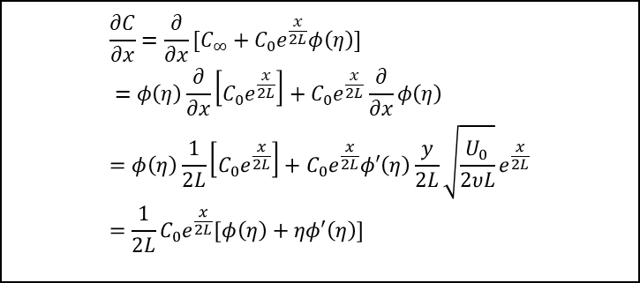
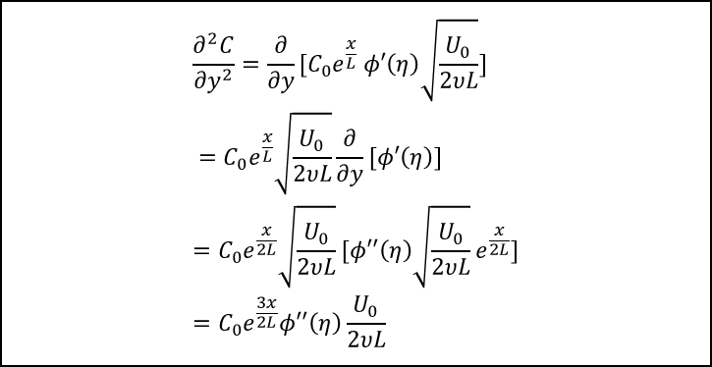
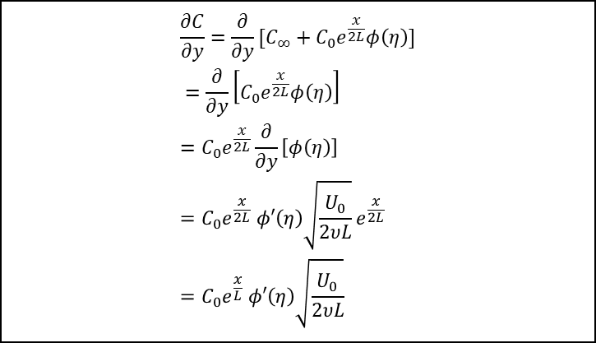
$$\frac{∂C}{∂x}=\frac{∂}{∂x}[{C_{∞}+C}_{0}e^{\frac{x}{2L}}φ\left(η\right)] \\ =φ\left(η\right)\frac{∂}{∂x}\left[C_{0}e^{\frac{x}{2L}}\right]+C_{0}e^{\frac{x}{2L}}\frac{∂}{∂x}φ\left(η\right) \\ =φ\left(η\right)\frac{1}{2L}\left[C_{0}e^{\frac{x}{2L}}\right]+C_{0}e^{\frac{x}{2L}}φ′\left(η\right)\frac{y}{2L}\sqrt{\frac{U_{0}}{2υL}}e^{\frac{x}{2L}} \\ =\frac{1}{2L}{C_{0}e}^{\frac{x}{2L}}[φ\left(η\right)+ηφ′\left(η\right)]$$
$$\frac{∂^{2}C}{∂y^{2}}=\frac{∂}{∂y}[C_{0}e^{\frac{x}{L}} φ′\left(η\right)\sqrt{\frac{U_{0}}{2υL}}] \\ =C_{0}e^{\frac{x}{L}}\sqrt{\frac{U_{0}}{2υL}}\frac{∂}{∂y}[φ′\left(η\right)] \\ =C_{0}e^{\frac{x}{2L}}\sqrt{\frac{U_{0}}{2υL}}[φ′′\left(η\right)\sqrt{\frac{U_{0}}{2υL}}e^{\frac{x}{2L}}] \\ =C_{0}e^{\frac{3x}{2L}}φ′′\left(η\right)\frac{U_{0}}{2υL}$$
$$\frac{∂C}{∂y}=\frac{∂}{∂y}[{C_{∞}+C}_{0}e^{\frac{x}{2L}}φ\left(η\right)] \\ =\frac{∂}{∂y}\left[C_{0}e^{\frac{x}{2L}}φ\left(η\right)\right] \\ =C_{0}e^{\frac{x}{2L}}\frac{∂}{∂y}\left[φ\left(η\right)\right] \\ =C_{0}e^{\frac{x}{2L}} φ′\left(η\right)\sqrt{\frac{U_{0}}{2υL}}e^{\frac{x}{2L}} \\ =C_{0}e^{\frac{x}{L}} φ′\left(η\right)\sqrt{\frac{U_{0}}{2υL}}$$

Slide 11
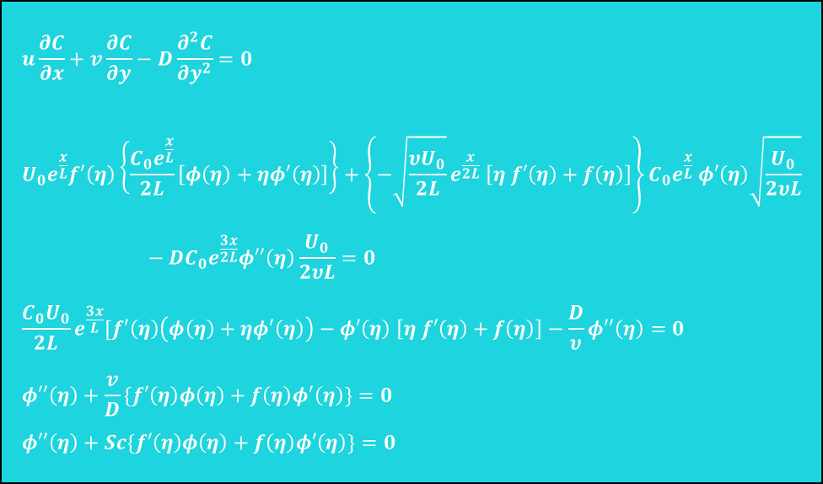
$$u\frac{∂C}{∂x}+v\frac{∂C}{∂y}−D\frac{∂^{2}C}{∂y^{2}}=0 \\ {U_{0}e}^{\frac{x}{L}}f′\left(η\right)\left\{\frac{C_{0}e^{\frac{x}{L}}}{2L}\left[φ\left(η\right)+ηφ′\left(η\right)\right]\right\}+{\left\{−\sqrt{\frac{{υU}_{0}}{2L}}e^{\frac{x}{2L}} \left[η f′\left(η\right)+f\left(η\right)\right]\right\}C}_{0}e^{\frac{x}{L}} φ′\left(η\right)\sqrt{\frac{U_{0}}{2υL}}−DC_{0}e^{\frac{3x}{2L}}φ′′\left(η\right)\frac{U_{0}}{2υL}=0 \\ \frac{C_{0}U_{0}}{2L}e^{\frac{3x}{L}}[f′\left(η\right)\left(φ\left(η\right)+ηφ′\left(η\right)\right)−φ′\left(η\right) \left[η f′\left(η\right)+f\left(η\right)\right]−\frac{D}{υ}φ′′\left(η\right)=0 \\ φ′′\left(η\right)+\frac{v}{D}\{f′\left(η\right)φ\left(η\right)+f\left(η\right)φ′\left(η\right)\}=0 \\ φ′′\left(η\right)+Sc\{f′\left(η\right)φ\left(η\right)+f\left(η\right)φ′\left(η\right)\}=0$$

Slide 12
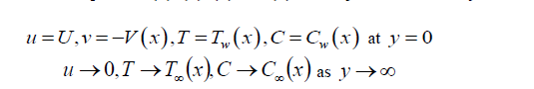
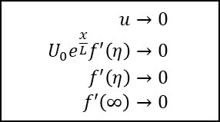
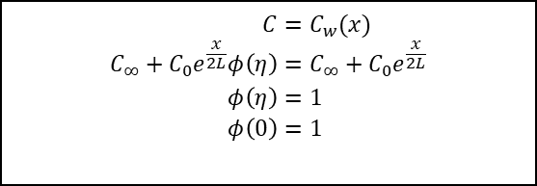
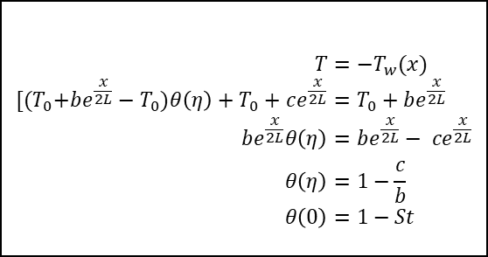

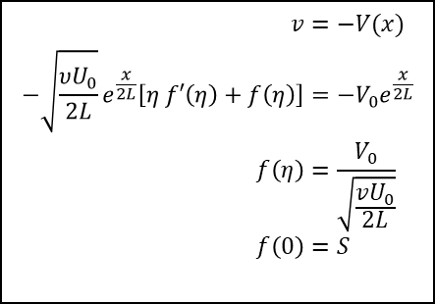
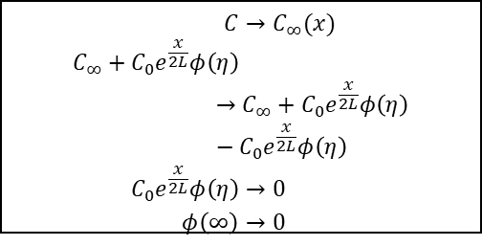
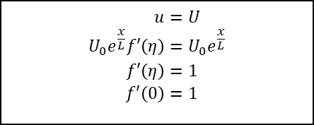
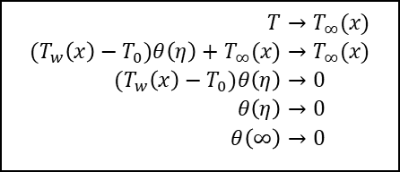
Boundary Conditions
When y=0
When y $→ ∞$
$$u→0 \\ {U_{0}e}^{\frac{x}{L}}f′\left(η\right)→0 \\ f′\left(η\right)→0 \\ f′\left(∞\right)→0$$
$$u=U \\ {U_{0}e}^{\frac{x}{L}}f′\left(η\right)={U_{0}e}^{\frac{x}{L}} \\ f′\left(η\right)=1 \\ f′\left(0\right)=1$$
$$T=−T_{w}(x) \\ {[(T}_{0}+be^{\frac{x}{2L}}−T_{0})θ\left(η\right)+T_{0}+ce^{\frac{x}{2L}}=T_{0}+be^{\frac{x}{2L}} \\ be^{\frac{x}{2L}}θ\left(η\right)=be^{\frac{x}{2L}}− ce^{\frac{x}{2L}} \\ θ\left(η\right)=1−\frac{c}{b} \\ θ\left(0\right)=1−St$$
$$T→T_{∞}(x) \\ {(T}_{w}\left(x\right)−T_{0})θ\left(η\right)+T_{∞}(x)→T_{∞}(x) \\ {(T}_{w}\left(x\right)−T_{0})θ\left(η\right)→0 \\ θ\left(η\right)→0 \\ θ\left(∞\right)→0$$
$$v=−V(x) \\ −\sqrt{\frac{{υU}_{0}}{2L}}e^{\frac{x}{2L}}\left[η f′\left(η\right)+f\left(η\right)\right]=−{V_{0}e}^{\frac{x}{2L}} \\ f\left(η\right)=\frac{V_{0}}{\sqrt{\frac{{vU}_{0}}{2L}}} \\ f\left(0\right)=S$$
$$C=C_{w}(x) \\ {C_{∞}+C}_{0}e^{\frac{x}{2L}}φ\left(η\right)=C_{∞}+C_{0}e^{\frac{x}{2L}} \\ φ\left(η\right)=1 \\ φ\left(0\right)=1$$
$$C→C_{∞}(x) \\ {C_{∞}+C}_{0}e^{\frac{x}{2L}}φ\left(η\right)→{C_{∞}+C}_{0}e^{\frac{x}{2L}}φ\left(η\right)−C_{0}e^{\frac{x}{2L}}φ\left(η\right) \\ C_{0}e^{\frac{x}{2L}}φ\left(η\right)→0 \\ φ\left(∞\right)→0$$

Slide 13



RESULTS

Slide 14

